Slide 1

University of Pisa
MASTER’S DEGREE IN COMPUTER ENGINEERING
INDUSTRIAL APPLICATIONS
PRESENTATION
STUDENT
AuraBeat
Tiruye, Mulat Ayinet
ID:684343

Slide 2
ABSTRACT
In this study, I present AuraBeat, a real-time multimedia system that reacts to user emotions using Facial Expression Recognition (FER). The goal is to enhance in-car user experience by automatically playing music that matches the detected mood.
A structured benchmark was conducted using real-world FER models including TinyCNN and DeepFace (OpenCV & RetinaFace). The system follows a frontend–backend architecture:
The frontend captures webcam input, performs emotion detection, and triggers music playback.
The backend logs emotion predictions and user feedback.
Although not deployed on Raspberry Pi, the system was optimized for browser-only and CPU-based execution, with future plans for embedded or cloud deployment.

Slide 3
Facial Expression-Driven Music Playback for In-Car Entertainment
Project Goal: Deliver real-time music based on passenger facial expressions.
Motivation: Improve user comfort by automating music selection through mood detection.
Key Technology: FER via webcam using DeepFace + TinyCNN, running on a browser-compatible setup.
Target Use Case: Offline-capable, browser-based system for cars — no login or cloud dependency.
Challenges:
No GPU: All models run on CPU
FPS limitations for complex models
UI must remain responsive and mobile-compatible
INTRODUCTION

Slide 4











FACIAL EXPRESSION RECOGNITION
INTEGRATION
FACIAL
EXPRESSION
RECOGNITION
AUTO-MUSIC SELECTIONS
EMOTION-BASED
PASSENGER
RATING
COMMENT AND
SUGGESTIONS
PLAYLISTS

Slide 5
Emotion-Aware Interfaces and FER Systems
FER in Automotive UX
Growing use for infotainment and driver/passenger monitoring
Enables adaptive systems (music, alerts, notifications)
2. Lightweight FER Models
TinyCNN & DeepFace are practical for CPU-only systems
Trade-off: Lower accuracy vs real-time FPS
STATE OF THE ART

Slide 6
Real-Time Systems & AuraBeat's Positioning
3. Real-Time FER Systems
Most academic systems assume cloud or GPU dependency
AuraBeat demonstrates local FER with usable FPS on low-end CPU
4. Data-Driven Adaptation
Feedback + emotion logs stored in MongoDB
Supports future training of a personalized mood classifier
5. Gap Addressed
AuraBeat fills the real-time, offline-capable gap in emotion-aware entertainment by providing a browser-deployable FER recommender without requiring special hardware or cloud infrastructure.
STATE OF THE ART

Slide 7




SYSTEM ARCHITECTURE
CAR CONTROLLER
Not implemented now
For future to integrate with like car speeds and emergencies
FRONT-END
BACK-END
MOBILE APP
USER/PASSENGER
DATABASE

Slide 8

SYSTEM REQUIREMENTS

Slide 9
Create a personal account;
Log in to access personal features;
Use webcam to capture emotion snapshot
Receive music suggestion based on detected mood
Provide star rating and optional feedback comment
View and replay previously played songs offline
USER/PASSENGER
FUNCTIONAL REQUIREMENTS
Log in to access management features;
Monitor system operations through a dashboard;
Manage user requests for data access, modification, or deletion;
Analyze system performance and generate reports;
Visualize valence/arousal trends (read-only)
View logs of user feedback (anonymous)
ADMIN

Slide 10
NF1.
ACCURACY AND CONSISTENCY
Uses lightweight model
Accuracy is good even its trained-on CPU
NF2.
SYSTEM USABILITY
One-click emotion detection
The system setup for new users can
be completed within 1 or 2minutes.
NON-FUNCTIONAL REQUIREMENTS
NF3.
SCALABILITY AND EXTENSIBILITY
The architecture can support the addition of new models to detect facial expressions.
NF4.
PRIVACY PROTECTION
Secure image (not stored) or personal data storage.

Slide 11

WORK PACKAGES

Slide 12
WP1: Database Configuration and Design
Timeline
Motivation
Duration: Month 1 → Month 2
Classification: Research & Innovation
To store and manage emotion detection logs, music playback history, and user feedback efficiently for offline/online use.
Must support simple queries and lightweight analytics via a local or cloud-based backend.
Goals
Key Tasks
Define schema for emotion, music, feedback
Enable storage in MongoDB + fallback to browser (LocalStorage)
Support basic analytics
Design collections/tables (emotions, feedback, tracks)
Implement MongoDB schema + fallback in LocalStorage
Create FastAPI endpoints to log/fetch data
Visualize stats on admin UI using Chart.js

Slide 13
WP1: Database Configuration and Design
Deliverables & Milestones
Dependencies
Schema + mock data: End of Month 1
Working DB + API endpoints: Mid-Month 2
Admin dashboard stats & logs: End of Month 2
WP2: Backend API development
WP5: Integration with admin and frontend
Tools
Effort & Cost
MongoDB (local)
LocalStorage (offline)
FastAPI (backend)
Chart.js (admin UI)
Role | Months | Person/Month
Backend Developer | 2 | 2
Project Manager | 0.5 | 0.5
Estimated Cost: | €12,000 (assuming €5k dev / €6k PM monthly rate)

Slide 14
WP2: Backend Development
Timeline
Motivation
Duration: Month 2 → Month 4
Classification: Research & Innovation
AuraBeat’s backend handles real-time emotion detection requests, serves music suggestions, logs feedback, and enables dashboard analytics.
It must be lightweight, fast, and privacy-compliant — using a modular RESTful API architecture.
Goals
Key Tasks
Setup FastAPI + routing structure
Implement endpoints: /detect-emotion, /log-emotion, /vibe-count, /admin-stats
Connect to MongoDB or fallback storage
Add stats logic (emotion count, average valence/arousal)
Build RESTful API in Python (FastAPI or Flask)
Integrate emotion models and connect to local/MongoDB storage
Log feedback, emotion results, and track events
Support frontend requests and admin analytics

Slide 15
WP2: Backend Development
Deliverables & Milestones
Dependencies
Month 2: Working API endpoints for emotion detection
Month 3: DB integration and feedback logging
Month 4: Admin analytics + final test validation
WP1 (Database): must be ready before backend testing
WP5 (Integration): uses backend endpoints
Tools
Effort & Cost
FastAPI (or Flask)
DeepFace (OpenCV backend)
MongoDB / LocalStorage
Chart.js for admin analytics
Postman + Pytest (API testing)
Role | Months | Person/Month
Backend Developer | 3 | 6
Project Manager | 1 | 1
Estimated Cost: | €36,000

Slide 16
WP3: Frontend Development
Timeline
Motivation
Duration: Month 5→ Month 6
Classification: Research & Innovation
The web interface is the main point of interaction for users to detect emotions, view mood-based music, and give feedback.
A lightweight, browser-based app ensures accessibility, offline use, and ease of testing without mobile installation.
Build UI pages: Emotion Detection, Music Player, Feedback Form
Integrate API calls: detectEmotion, getTrack, submitFeedback
Enable local caching of results & music (offline mode)
Implement emotion visuals (emoji, valence/arousal graph)
Goals
Key Tasks
Design a clean, intuitive web UI (React-based)
Integrate with backend for real-time emotion detection & music control
Enable feedback form submission, local history viewing

Slide 17
WP3: Frontend Development
Deliverables & Milestones
Dependencies
UI + feature complete React app: End of Month 5
Backend integrated and tested: Mid Month 6
Dashboard visuals + offline mode tested: End of Month 6
WP2 (Backend): Needed to fetch emotion and music
WP5 (Integration): Needed for packaging and demo
Tools
Effort & Cost
React.js, Chart.js, Axios
LocalStorage & Static Assets (MP3s)
Vite/Node for dev environment
Browser DevTools + manual testing (no mobile app)
Role | Months | Person/Month
Frontend Developer | 2 | 4
Project Manager | 0.5 | 0.5
Estimated Cost: | €11,000

Slide 18
WP4: System Integration
Timeline
Motivation
Duration: Month 7 → Month 8
Classification: Support and Services
System integration ensures smooth interaction between the frontend, backend, and database, validating that emotion detection, music recommendation, and feedback collection work seamlessly end-to-end.
Goals
Key Tasks
Ensure consistent data flow across all modules
Validate backend-frontend and backend-database communication
Resolve bugs and optimize API response under user testing
Configure local/cloud test environment
Test API routes for emotion detection, logging, feedback
Simulate full user session (webcam → emotion → music → feedback)
Monitor local storage sync with backend DB
Fix latency or crash issues
Validate analytics on admin dashboard

Slide 19
WP4: System Integration
Deliverables & Milestones
Dependencies
Month 7: Test setup + DB/backend integration
Month 8 (mid): Frontend/backend fully validated
Month 8 (end): Final test report with bug fixes and dashboard results
WP1: DB schema and logging must be complete
WP2: Backend API must be stable
WP3: Frontend components must be ready
Tools
Effort & Cost
FastAPI test server
MongoDB local/cloud
Browser + Postman for test execution
Manual test logs, CSV output for evaluation
Role | Months | Person/Month
System Integrator | 2 | 2
Project Manager | 0.5 | 0.5
Estimated Cost: | €15,000

Slide 20
WP5: Security and Privacy
Timeline
Motivation
Duration: Month 6 → Month 7
Classification: support and services
AuraBeat requires secure handling of emotional data and user feedback.
This WP ensures data is processed safely, stored with encryption when needed, and used in compliance with GDPR. No login or identity data is stored.
Goals
Key Tasks
Secure data transmission between frontend, backend, and DB
Encrypt stored feedback and emotion logs
Apply privacy policies: no image retention, no PII logging
Apply TLS for backend endpoints (FastAPI HTTPS)
Enable AES-256 encryption (where DB is used)
Implement anonymized feedback (no IP, no identity)
Validate local storage doesn’t retain faces/images
Add banner/info for data rights compliance (GDPR-lite)
Run basic security test scripts (input injection, endpoint checks)

Slide 21
WP5: Security and Privacy
Deliverables & Milestones
Dependencies
Month 6: TLS enabled + encrypted storage applied
Mid Month 7: Feedback anonymization + validation done
End Month 7: GDPR disclaimer active, security checklist passed
WP1 (DB): Must be secured for feedback storage
WP2 (Backend): Needed for endpoint security
WP4 (Integration): End-to-end test paths for attacks
Tools
Effort & Cost
TLS cert (self-signed or OpenSSL)
PyCryptodome (AES encryption)
PyJWT (if session required, optional)
Postman tests, Burp Suite (lite)
Role | Months | Person/Month
Security Experts | 2 | 2
Project Manager | 0.5 | 0.5
Estimated Cost: | €14,000

Slide 22
WP6: System Testing and Acceptances
Timeline
Motivation
Duration: Month 1 → Month 9
Classification: Support and Services
Ensure system correctness, reliability, and robustness through comprehensive testing (unit, integration, end-to-end, performance).
Goals
Key Tasks
Validate all functional and non-functional requirements.
Identify and resolve bugs or issues across system components.
Confirm system integrates all modules correctly.
Ensure robustness under load and stress.
Unit Testing: Code coverage >80%, covers DB, backend, frontend, car controller.
Integration Testing: Validate DB, backend, car controller, frontend APIs.
End-to-End Testing: Simulate user journeys, ensure data integrity.
Performance Testing: Load tests, API response time <200ms.
Security Testing: Confirm encryption/authentication work; simulate attacks.
Issue Resolution: Analyze test results, fix, and retest.

Slide 23
WP6: System Testing and Acceptances
Deliverables & Milestones
Dependencies
Test Design: All test cases finalized (End of Month 1)
Unit Testing Completed (Month 6)
End-to-End + Security Testing (Month 8)
Final Integration Testing (Mid-Month 9)
Deliverables: Testing Report, Validated System Confirmation, Test Logs
WP1 (DB), WP2 (Backend), WP4 (Frontend), WP5 (Integration), WP6 (Security)
Effort & Cost
Tools
Role | Months | Person/Month
QA Engineer | 4 | 8
System Engineer | 2 | 2
Project Manager | 2 | 2
Estimated Cost: | €50,000
Unit Testing: pytest (backend), Jest (frontend)
Simulation: Apache Jmeter
Security Testing: OWASP ZAP, Burp Suite
Environment: Virtual or dedicated servers

Slide 24
GANTT CHART
 | M1 | M2 | M3 | M4 | M5 | M6 | M7 | M8 | M9
WP1
WP2
WP3
WP4
WP5
WP6

Slide 25

&
ROLES
RESPONSIBILITIES

Slide 26

Leads the project timeline and coordinates all work packages (WP1–WP7).
Ensures deliverables, tracks milestones, and mitigates risks.
Requires strong communication, leadership, and software development lifecycle (SDLC) knowledge.
PROJECT MANAGER
BUDGET
€6.000/MONTH

Slide 27

Designs and optimizes relational and non relational databases (e.g., MySQL, PostgreSQL, MongoDB).
Ensures query efficiency and data integrity.
Needs SQL proficiency, and analytical mindset.
DATABASE DEVELOPER
BUDGET
€5.000/MONTH

Slide 28

Builds and maintains backend systems with RESTful APIs.
Integrates security protocols (e.g., TLS, token auth).
Proficient in Python, Flask/FastAPI, and testing tools.
BACKEND DEVELOPER
BUDGET
€5.000/MONTH

Slide 29

Designs data pipelines and ensures efficient handling/storage.
Collaborates on backend workflow optimization.
Skilled in SQL, Python, and modern data tools.
DATA ENGINEER
BUDGET
€5.000/MONTH

Slide 30

Programs edge devices (e.g., Jetson Nano, Coral TPU).
Integrates CAN bus for vehicle data.
Uses TensorFlow Lite/PyTorch for deploying AI models
EMBEDDED DEVELOPER
BUDGET
€5.500/MONTH

Slide 31

Develops cross-platform mobile apps (Android/iOS), web apps.
Implements UI/UX features for evaluations and feedback.
Experienced in REACT,JS, and Axios.
FRONTEND DEVELOPER
BUDGET
€4.000/MONTH

Slide 32

Oversees integration of backend, DB, and frontend.
Validates data flow and resolves component interaction issues.
Familiar with Postman, Grafana, and integration principles.
SYSTEM INTEGRATOR
BUDGET
€6.000/MONTH

Slide 33

Implements security protocols, performs vulnerability testing.
Ensures GDPR compliance and monitors for threats.
Skilled in AES-256, TLS 1.3, OWASP ZAP, and JWT.
SECURITY ENGINEER
BUDGET
€5.500/MONTH

Slide 34

Leads unit, integration, and end-to-end testing (WP7).
Identifies bugs and simulates high-load conditions.
Proficient in pytest, Jest, Apache JMeter, and Postman.
QUALITY ASSURANCE ENGINEER
BUDGET
€5.000/MONTH

Slide 35
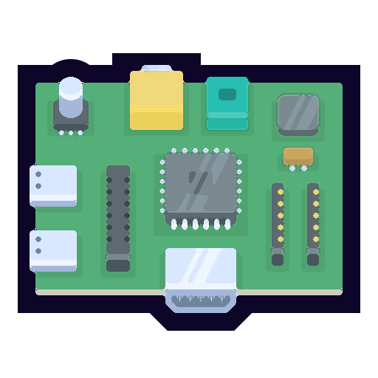

THE PROTOTYPE
FER DEPLOYMENT ON AN EDGE DEVICE
Not Implemented now
DATA STORED ON MONGODB

Slide 36
DEVELOPMENT MACHINE SPECS
Processor: Intel Core i5-8250U, 4 cores / 8 threads
Memory: 8 GB DDR4 RAM
Operating System: Windows 10 (or Linux if dual booted)
GPU: Intel UHD Graphics + NVIDIA GeForce MX130
Camera: Integrated HD Webcam
Software Stack: Python, OpenCV, Flask, DeepFace
DEVELOPMENT
HARDWARE SETUP

Slide 37

Webcam
OpenCV
Camera Integration
Diagram
DeepFace Emotion Recognition
Emotion + Valence/Arousal
Music Mapping

Slide 38

AuraBeat -Emotion Detection Workflow
Webcam Snapshot
FRAME
FACE DETECTOR
OpenCV
DeepFace Face Detector
DeepFace Emotion Model
8 EMOTION CLASSES
FACIAL EXPRESSION RECOGNITION

Slide 39

THE DATA COLLECTION & MODEL TRAINING PIPELINE
Pretrained Models Evaluated Using FER2013 Dataset
Used for benchmarking accuracy of DeepFace and TinyCNN on 7 emotion classes.
Live Emotion Capture via Webcam
Frontend captures user webcam input; backend performs real-time inference.
Centralized MongoDB Storage
All emotion snapshots, timestamps, and feedback entries are stored securely for analysis.

Slide 40
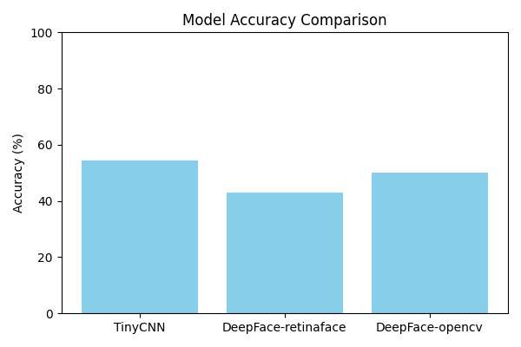
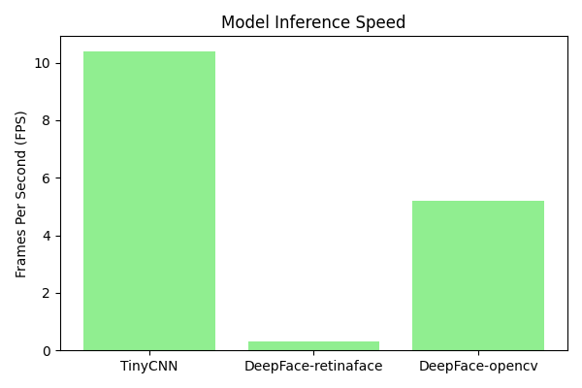
TinyCNN
DeepFace (OpenCV)
DeepFace (RetinaFace)
Acc: 54.29 % FPS: 10.4 Fastest & suitable for real-time
Acc: 42.86%
FPS: 0.30
High precision, too slow
Acc: 50 %
FPS: 5.19
Good balance, can be used in deployment
Performance Evaluation
(Laptop Test Environment)

Slide 41

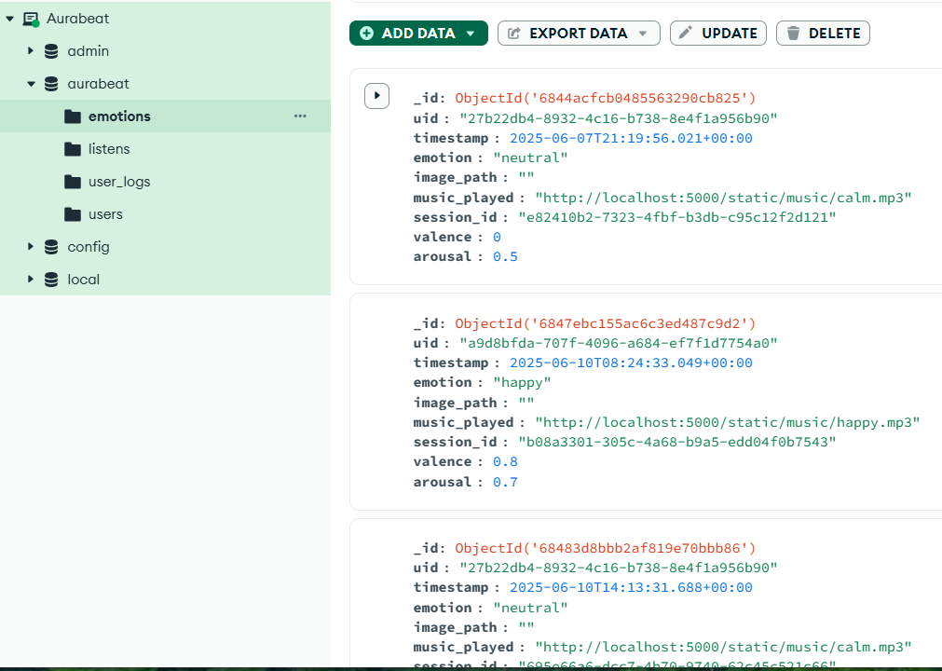

BACKEND MODULE
Processes video inputs using AI-based emotion detection models.
Stores emotional data and feedback securely in a structured database.
Includes a robust API layer for efficient data exchange and future model integration.
DATABASE
MONGODB
BACK-END
FLASK

Slide 42
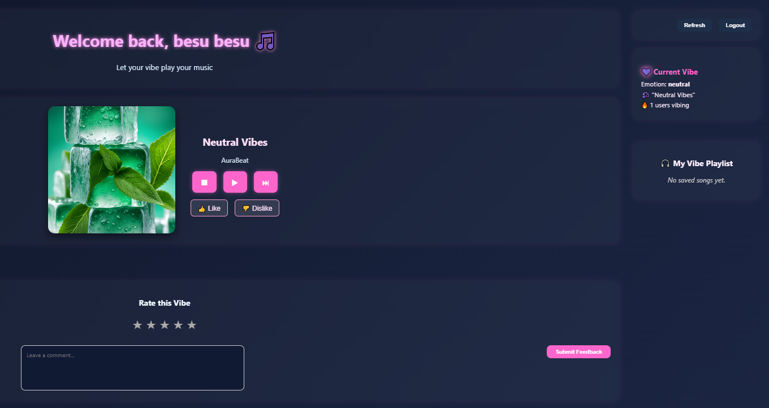

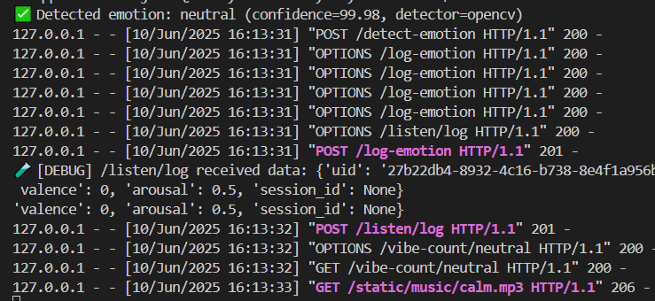

USER PAGE:
FRONTEND MODULE
FRONT-END
REACT
WEB APP

Slide 43
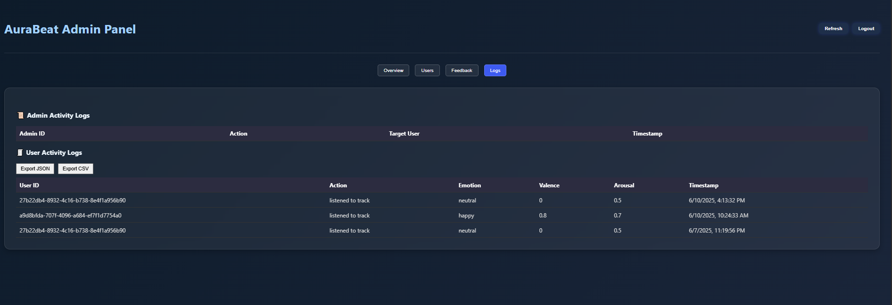
ADMIN PAGE: OVERVIEW
FRONTEND MODULE
FRONT-END
REACT
WEB APP

Slide 44
Conclusion:
Successfully developed a real-time emotion-based feedback and music system using webcam input.
Integrated DeepFace and TinyCNN models with moderate accuracy and live performance.
Achieved ~10 FPS (TinyCNN) with meaningful feedback capture and user interaction.
Demonstrated potential for scalable emotional context-aware applications.
CONCLUSION AND FUTURE DIRECTION
Future direction:
Deploy on edge devices (e.g., Raspberry Pi or Jetson Nano) for real-world in-vehicle use.
Enhance accuracy using ONNX-based or transformer FER models (e.g., ViT, RMN).
Expand system to support real-time user adaptation, voice sentiment, or gesture inputs.

Slide 45
THANK YOU
FOR YOUR ATTENTION!

Slide 46
REFERENCES
[1]
DRIVER EMOTION RECOGNITION FOR INTELLIGENT VEHICLES: A SURVEY (2020)
https://www.media.mit.edu/publications/driver-emotion-recognition-for-intelligent-vehicles-a-survey/
[2]
AUDIOVISUAL AFFECT RECOGNITION FOR AUTONOMOUS VEHICLES: APPLICATIONS, CHALLENGES, AND OPPORTUNITIES (2023)
https://ieeexplore.ieee.org/document/10337780
[3]
REVIEW AND PERSPECTIVES ON HUMAN EMOTION FOR CONNECTED AUTOMATED VEHICLES (2023)
https://link.springer.com/article/10.1007/s42154-023-00270-z

Slide 47
REFERENCES
[4]
PLATFORM-MEDIATED REPUTATION SYSTEMS IN THE SHARING ECONOMY (2020)
https://www.academia.edu/77030822/Platform_mediated_reputation_systems_in_the_sharing_economy_and_incentives_to_provide_service_quality_the_case_of_ridesharing_services
[5]
A SYSTEMATIC LITERATURE REVIEW OF RIDE-SHARING PLATFORMS, USER FACTORS, AND BARRIERS (2021)
https://etrr.springeropen.com/articles/10.1186/s12544-021-00522-1
[6]
UNDERSTANDING RIDE-SHARING SYSTEMS IN URBAN AREAS: LOCATION, USERS, AND BARRIERS (2020)
https://www.academia.edu/76607239/Understanding_Ride_Sharing_Systems_in_Urban_Areas_The_Role_of_Location_Users_and_Barriers

